Slide 1
Going serverless From on-premise to the cloud
Wrocław, ??.05.2020, Tomasz Strzałka

Slide 2
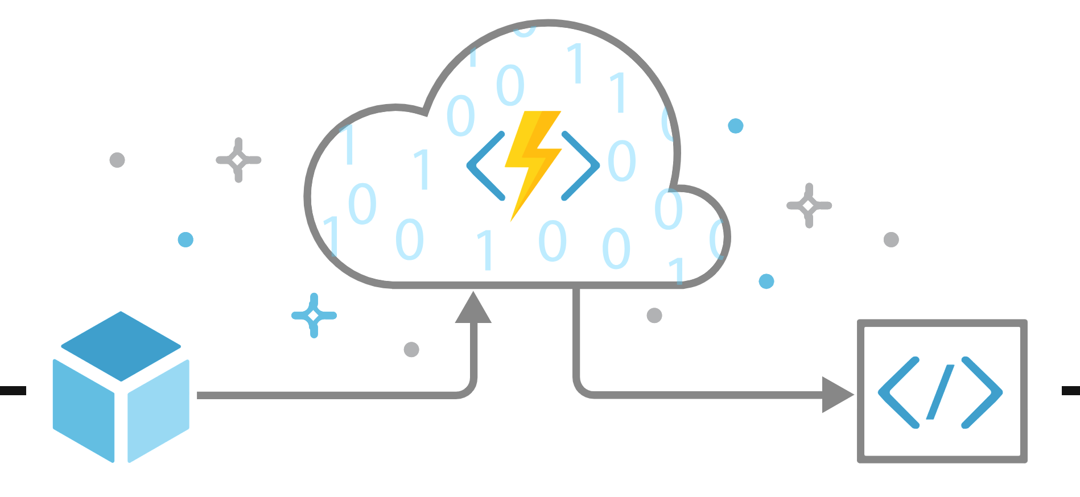

What is Azure?
Microsoft Azure is an ever-expanding set of cloud services to help your organization meet your business challenges.
It’s the freedom to build, manage, and deploy applications on a massive, global network using your favorite tools and frameworks.
Microsoft Azure Overview

Slide 3

What are Azure Functions?
More than just event-driven serverless compute.
Microsoft Azure Overview
Azure Function is a serverless, stateless peace of code which is run by the trigger, able to connect to other Azure services to read and/or write data.
@Me

Slide 4









Run by a trigger?
Timer Trigger
Azure Blob Storage
Azure Service Bus
Topic
Azure Cosmos DB
Azure Service Bus
Queue
Azure Queue Storage
Azure Event Grid
Azure IoT Hubs
Azure Event Hubs
HTTP Trigger

Slide 5

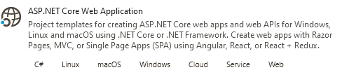


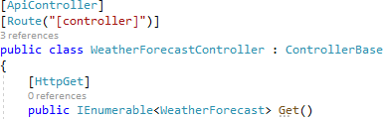

HTTP API
API Template
HTTP Trigger
Entity Framework Core
Azure Cosmos DB

Slide 6
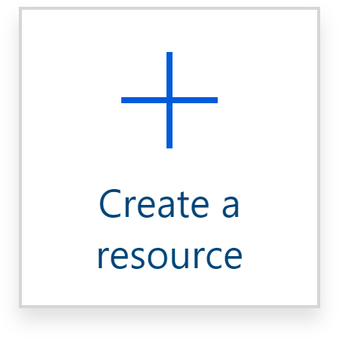





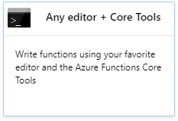
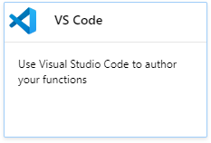
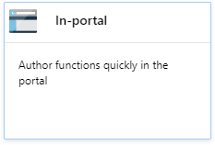
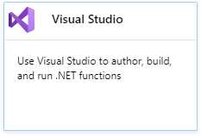
HTTP API
Demo
Create storage account
( , , , )
HTTP Trigger
Create Function App
Azure Cosmos DB

Slide 7
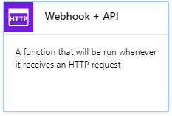
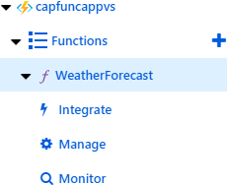
HTTP API
Demo
Create storage account
( , , , )
Create Function App

Slide 8


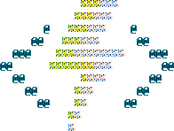
C# Functions
C# script
C# class library
Azure WebJobs SDK based
Runtime
Azure Function Core Tools based
Compilation
JIT compilation
AoT compilation
Bindings
In-portal configuration
In-code configuration
function.json
Convention-based
Runtime-based
Attribute-based
Convention-based
Runtime-based

Slide 9


Bindings
Inputs
Outputs
Azure Queue Storage
Azure Blob Storage
HTTP
Azure Service Bus
Azure Table Storage
Azure Blob Storage
Azure Table Storage
Orchestration Client
Durable Client
Azure Cosmos DB
SignalR Connection Info
Azure Event Hubs
SendGrid
Twilio SMS
Azure Cosmos DB
SignalR

Slide 10


Bindings
Trigger
Input
Function
Output
Trigger
Input
Function
…

Slide 11
HTTP API

